Slide 1
Chapter 1 Computer Abstractions and Technology

Slide 2
Computer Technology
Incredible performance improvements:
Improvements in semiconductor technology
Feature size, clock speed
Improvements in computer architectures (computer design)
Lead to RISC (Reduced Instruction Set Computer) architectures
Instruction level parallelism (ILP)
Use of caches
Together have enabled:
Lightweight computers
Productivity-based managed/interpreted programming languages

Slide 3
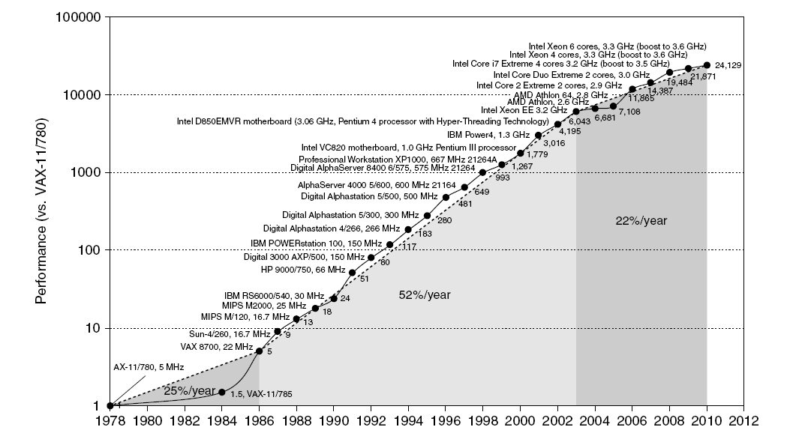
Single Processor Performance
Move to multi-processor
RISC

Slide 4
Current Trends in Architecture
Cannot continue to leverage Instruction-Level parallelism (ILP)
Single processor performance improvement ended in 2003
New models for performance:
Data-level parallelism (DLP)
Thread-level parallelism (TLP)
Request-level parallelism (RLP)
These require explicit restructuring of the application

Slide 5
Classes of Computers
Personal Mobile Device (PMD)
e.g. cell phones, tablet computers
Cost and size
Energy efficiency: use of batteries and absence of fan for cooling
Flash memory for storage instead of magnetic disks.
Desktop Computing
Emphasis on price-performance
Servers
Provide large-scale and reliable file and computing services.
Emphasis on availability, scalability, throughput
Clusters / Warehouse Scale Computers
Clusters: a collection of servers connected by LAN to act as a single larger computer.
Used for “Software as a Service (SaaS)”
Emphasis on availability and price-performance
Embedded Computers
e.g. microwaves, washing machines, printers, network switches, and cars
Emphasis: price

Slide 6
Class of Parallelism & Parallel Architectures
Classes of parallelism in applications:
Data-Level Parallelism (DLP)
There are many data items that can be operated on at the same time.
Task-Level Parallelism (TLP)
Tasks of work can operate independently and largely in parallel.
Classes of architectural parallelism:
Instruction-Level Parallelism (ILP)
DLP using pipelining
Vector architectures/Graphic Processor Units (GPUs)
DLP by applying a single instruction to a collection of data in paralle.
Thread-Level Parallelism
DLP or TLP
Request-Level Parallelism

Slide 7
Flynn’s Taxonomy
Single instruction stream, single data stream (SISD)
Uniprocessor
Standard sequential computer + ILP
Single instruction stream, multiple data streams (SIMD)
The same instruction is executed by multiple processors using different data streams.
A single instruction memory and control processor
Multiple data processor and each processor has its own data memory.
Multiple instruction streams, single data stream (MISD)
No commercial implementation
Multiple instruction streams, multiple data streams (MIMD)
Task-level parallelism
Each processor fetches its own instructions and operates on its own data.

Slide 8
Next
Defining Computer Architecture
Trends in Technology
Performance

Slide 9
Defining Computer Architecture
“Old” view of computer architecture:
Instruction Set Architecture (ISA) design
i.e. decisions regarding:
registers, memory addressing, addressing modes, instruction operands, available operations, control flow instructions, instruction encoding
“Real” computer architecture:
Specific requirements of the target machine
Design to maximize performance within constraints: cost, power, and availability
Includes ISA, microarchitecture, hardware

Slide 10
Instruction Set Architecture
Instruction set architecture: a specification of a standardized programmer-visible interface to hardware, comprised of:
Instructions and Instruction Formats
Data Types, Encodings, and Representations
Programmable Storage: Registers and Memory
Memory addressing
Addressing Modes: to address Instructions and Data
Handling Exceptional Conditions (like division by zero)
software
instruction set
hardware

Slide 11
Instruction Set Architecture
Class of ISA
Stack, accumulator, general purpose register architectures
Memory addressing
All desktop and server computers use byte addressing to access memory operands.
Some architectures require that objects must be aligned.
Addressing mode
Types and sizes of operands
Operations
Control flow instructions
(Conditional) branches, (Unconditional) jumps, procedure calls and returns
Encoding an ISA

Slide 12
Classifying Architectures
One important classification scheme is by the type of addressing modes supported.
Stack architecture: Operands implicitly on top of a stack. (Early machines.)
Accumulator architecture: One operand is implicitly an accumulator (a special register). (Early machs.)
General-purpose register architecture: Operands may be any of a large (typically 10s-100s) # of registers.
Register-memory architectures: One op may be memory.
Load-store architectures: All ops are registers, except in special load and store instructions.

Slide 13
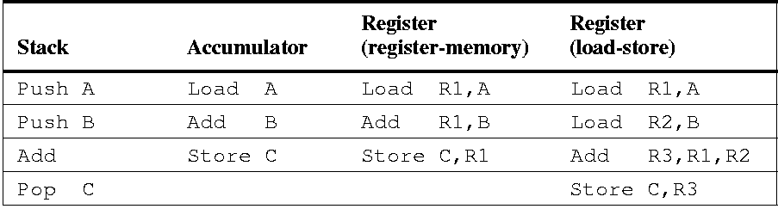
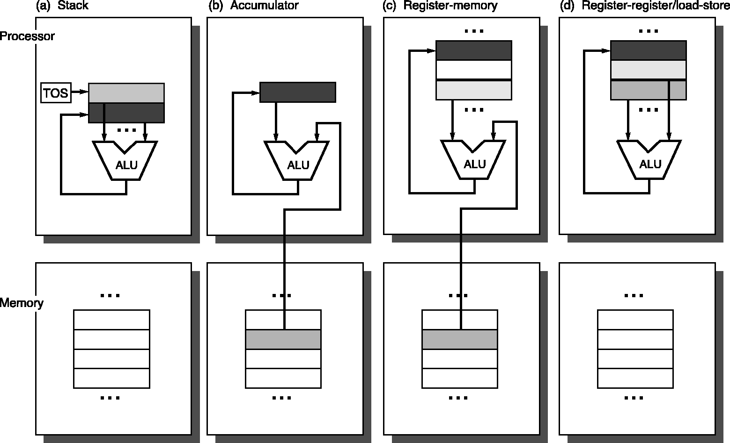
Four Architecture Classes
Assembly for C:=A+B:

Slide 14
Memory Addressing
Addressing Memory: how to specify and interpret memory address is important since all data are initially in the memory.
Interpreting Memory Addresses
What object is accessed as a function of address and length?
All computers provide access for bytes, half-words (2 bytes), words (4 bytes), and double words (8 bytes)
Alignment of bytes
An access to an object of size s bytes at byte address A is aligned if A mod s = 0. Memory is aligned on a multiple of a word or double-word boundary.
Misalignment causes extra memory accesses and HW costs

Slide 15
Byte Ordering and Endianness
Processors can order bytes within a word in two ways
Little Endian Byte Ordering
Memory address = Address of least significant byte
Example: Intel IA-32, Alpha
Big Endian Byte Ordering
Memory address = Address of most significant byte
Example: SPARC, PA-RISC
Byte ordering can be a problem when exchanging data between computers with different ordering conventions
MSB
LSB
address
a
a+1
a+2
a+3
Byte 3
Byte 2
Byte 1
Byte 0
. . .
Byte 0
Byte 1
Byte 2
Byte 3
. . .
32-bit Register
Memory
MSB
LSB
address
a
a+1
a+2
a+3
Byte 3
Byte 2
Byte 1
Byte 0
. . .
Byte 3
Byte 2
Byte 1
Byte 0
. . .
32-bit Register
Memory

Slide 16
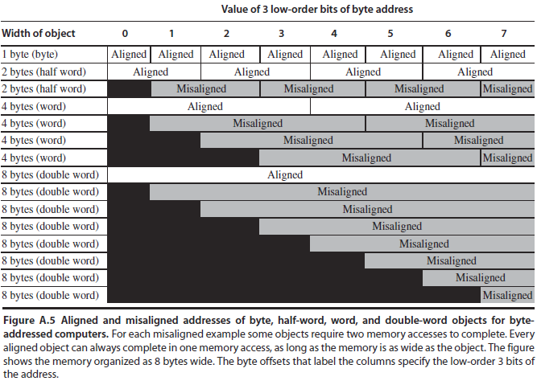

Slide 17
Addressing Modes
In example assembly syntax in middle column, ( ) indicates memory access. (A typical syntax.)
In RTL syntax on right, [ ] denotes accessing a member of an array, Register or Memory.

Slide 18
Type and Size of Operands
Opcode designates operand types in all modern computers
Character: 8-bit, usually in ASCII
16-bit Unicode: used in Java is gaining popularity
Integers: are almost universally represented as two’s complement binary numbers – short integer (half-word), integer (word), long integer (double-word)
Single-precision (1-word) and double-precision (2-word) floating point: the IEEE float-point standard, IEEE standard 754

Slide 19
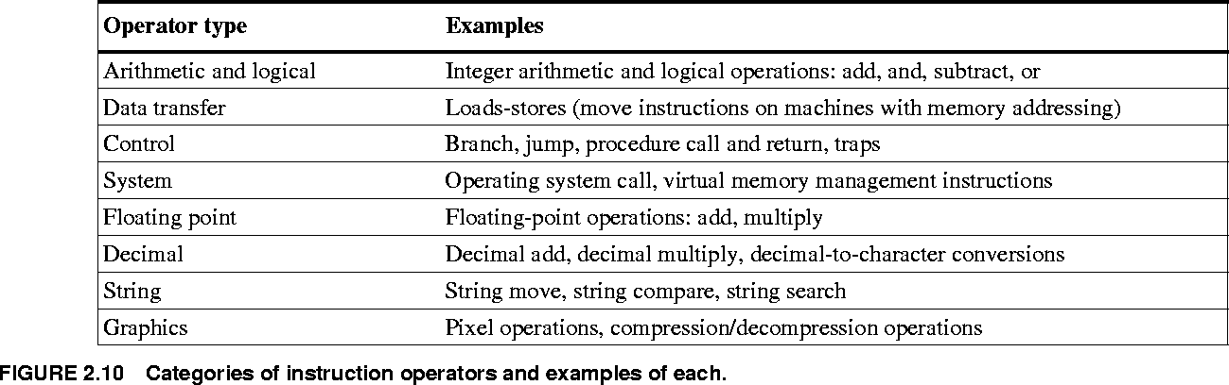
Operations

Slide 20
Control Flow Instructions
Four basic types:
(Conditional) branches
(Unconditional) jumps
Procedure calls
Procedure returns
Control flow addressing modes:
Often PC-relative (PC + displacement).
Target is often near the current instruction.
Specifying the position relative to current PC requires fewer bits.
Relocatable, position independence
Also useful: register indirect jumps (reg. has addr.):
Procedure returns

Slide 21
Conditional Branch Options
Condition Code (CC) Register
E.g.: X86, ARM, PPC, SPARC, …
ALU ops set condition code flags in the CCR
Branch just checks the flag
Condition register
E.g.: Alpha, MIPS
Comparison instruction puts result in a GPR
Branch instruction checks the register
Compare & Branch
E.g.: PA-RISC, VAX
Compare & branch in 1 instruction.

Slide 22
Procedure Calling Conventions
Two major calling conventions:
Caller saves:
Before the call, procedure caller saves registers that will be needed later, even if callee did not use them
Callee saves:
Inside the call, called procedure saves registers that it will overwrite
Can be more efficient if many small procedures
Many architectures use a combination of schemes:
E.g., MIPS: Some registers caller-saves, some callee-saves

Slide 23
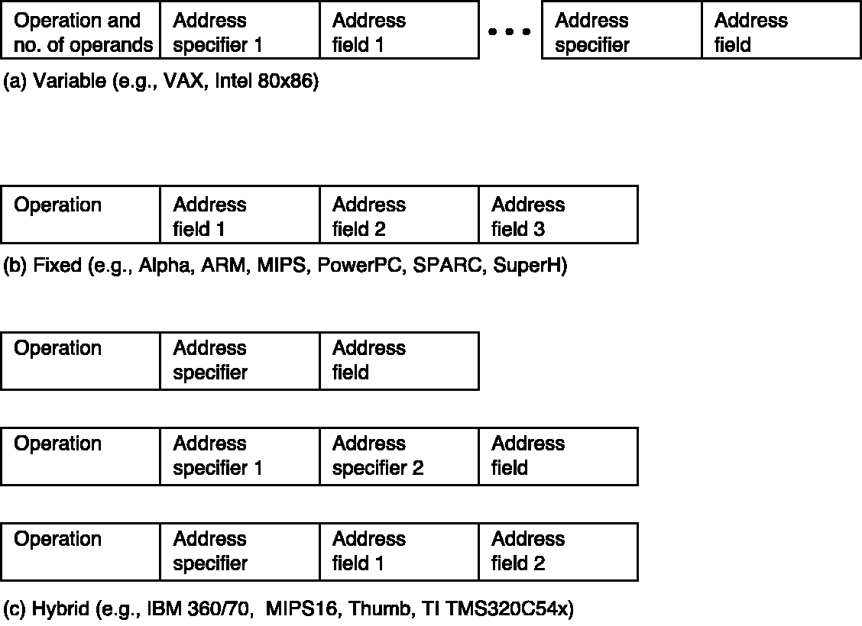
Encoding An Instruction Set
Support any number of operands
Each address specifier determining the addressing mode and the length of the specifier for that operand.
Enables the smallest code representation
Always has the same number of operands
The addressing mode is specified as part of opcode.
Largest code size.
Opcode specifies the instruction formats.
Add one or two fields to specify the address mode and one or two fields to specify the operand fields.

Slide 24
Next
Defining Computer Architecture
Trends in Technology
Performance

Slide 25
Trends in Technology
Integrated circuit technology
Transistor density: 35%/year
Die size: 10-20%/year
Transistor count on a chip: 40-55%/year, or doubling every 18 to 24 months. (Moore’s Law)
DRAM capacity: 25-40%/year (slowing)
Flash capacity: 50-60%/year
15-20X cheaper/bit than DRAM
Magnetic disk technology: 40%/year
15-25X cheaper/bit then Flash
300-500X cheaper/bit than DRAM

Slide 26
Performance Trends: Bandwidth and Latency
Bandwidth or throughput
Total work done in a given time
Megabytes per second for a disk transfer
10,000-25,000X improvement for processors
300-1200X improvement for memory and disks
Latency or response time
Time between start and completion of an event
Milliseconds for a disk access
30-80X improvement for processors
6-8X improvement for memory and disks

Slide 27
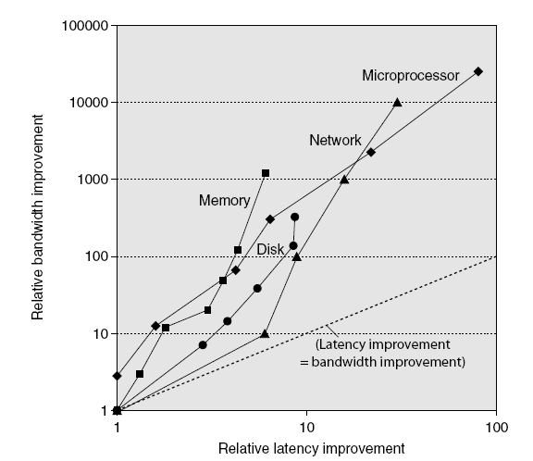
Performance Trends: Bandwidth and Latency
Log-log plot of bandwidth and latency milestones

Slide 28
Next
Defining Computer Architecture
Trends in Technology
Performance

Slide 29
Response Time and Throughput
Response Time
Time between start and completion of a task, as observed by end user
Response Time = CPU Time + Waiting Time (I/O, OS scheduling, etc.)
Also referred to as execution time.
Throughput
Number of tasks the machine can run in a given period of time
Decreasing execution time improves throughput
Example: using a faster version of a processor
Less time to run a task ⇒ more tasks can be executed
Increasing throughput can also improve response time
Example: increasing number of processors in a multiprocessor
More tasks can be executed in parallel
Execution time of individual sequential tasks is not changed
But less waiting time in scheduling queue reduces response time
Notes:
Have them raise their hands when answering questions

Slide 30
Definition of Performance
For some program running on machine X
X is n times faster than Y
1
Performance_{X} =
Execution time_{X}
Performance_{X}
Execution time_{Y}
=
= n
Performance_{Y}
Execution time_{X}

Slide 31
What do we mean by Execution Time?
Real Elapsed Time
Counts everything:
Waiting time, Input/output, disk access, OS scheduling, … etc.
Useful number, but often not good for comparison purposes
Our Focus: CPU Execution Time
Time spent while executing the program instructions
Doesn't count the waiting time for I/O or OS scheduling
Can be measured in seconds, or
Can be related to number of CPU clock cycles

Slide 32
Clock Cycles
Clock cycle = Clock period = 1 / Clock rate
Clock rate = Clock frequency = Cycles per second
1 Hz = 1 cycle/sec 1 KHz = 10³ cycles/sec
1 MHz = 10⁶ cycles/sec 1 GHz = 10⁹ cycles/sec
2 GHz clock has a cycle time = 1/(2×10⁹) = 0.5 nanosecond (ns)
We often use clock cycles to report CPU execution time
Cycle 1
Cycle 2
Cycle 3
CPU Execution Time = CPU cycles × cycle time
CPU cycles
=
Clock frequency

Slide 33
Improving Performance
To improve performance, we need to
Reduce number of clock cycles required by a program, or
Reduce clock cycle time (increase the clock rate)
Example:
A program runs in 10 seconds on computer X with 2 GHz clock
What is the number of CPU cycles on computer X ?
We want to design computer Y to run same program in 6 seconds
But computer Y requires 10% more cycles to execute program
What is the clock rate for computer Y ?
Solution:
CPU cycles on computer X = 10 sec × 2 × 10⁹ cycles/s = 20 × 10⁹
CPU cycles on computer Y = 1.1 × 20 × 10⁹ = 22 × 10⁹ cycles
Clock rate for computer Y = 22 × 10⁹ cycles / 6 sec = 3.67 GHz

Slide 34
Clock Cycles per Instruction (CPI)
Instructions take different number of cycles to execute
Multiplication takes more time than addition
Floating point operations take longer than integer ones
Accessing memory takes more time than accessing registers
CPI is an average number of clock cycles per instruction
I1
I2
I3
I4
I5
I6
I7
CPI =
14/7 = 2
1
2
3
4
5
6
7
8
9
10
11
12
13
14
cycles

Slide 35
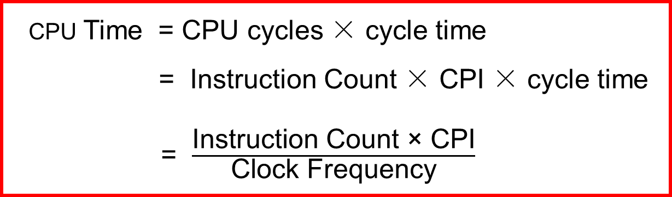
Performance Equation
We can relate CPU clock cycles to instruction count
Performance Equation: (related to instruction count)
CPU cycles = Instruction Count × CPI
CPU Time = CPU cycles × cycle time
= Instruction Count × CPI × cycle time
= $\frac{\text{Instruction} \text{Count}\text{ × }\text{CPI}}{\text{Clock} \text{Frequency}}$

Slide 36
Using the Performance Equation
Suppose we have two implementations of the same ISA
For a given program
Machine A has a clock cycle time of 250 ps and a CPI of 2.0
Machine B has a clock cycle time of 500 ps and a CPI of 1.2
Which machine is faster for this program, and by how much?
Solution:
Both computer execute same count of instructions = n
CPU execution time (A) = n × 2.0 × 250 ps = 500 × I ps
CPU execution time (B) = n × 1.2 × 500 ps = 600 × I ps
Computer A is faster than B by a factor = = 1.2
600 × n
500 × n

Slide 37
Determining the CPI
Different types of instructions have different CPI
Let CPI_{i} = clocks per instruction for class i of instructions
Let C_{i} = instruction count for class i of instructions
Designers often obtain CPI by a detailed simulation
Hardware counters are also used for operational CPUs
CPI =
n
∑
(CPI_{i} × C_{i})
CPU cycles = (CPI_{i} × C_{i})
n
∑
i = 1
n
∑
i = 1
C_{i}
i = 1

Slide 38
Example on Determining the CPI
Problem
A compiler designer is trying to decide between two code sequences for a particular machine. Based on the hardware implementation, there are three different classes of instructions: class A, class B, and class C, and they require one, two, and three cycles per instruction, respectively.
The first code sequence has 5 instructions: 2 of A, 1 of B, and 2 of C
The second sequence has 6 instructions: 4 of A, 1 of B, and 1 of C
Compute the CPU cycles for each sequence. Which sequence is faster?
What is the CPI for each sequence?
Solution
CPU cycles (1st sequence) = (2×1) + (1×2) + (2×3) = 2+2+6 = 10 cycles
CPU cycles (2nd sequence) = (4×1) + (1×2) + (1×3) = 4+2+3 = 9 cycles
Second sequence is faster, even though it executes one extra instruction
CPI (1st sequence) = 10/5 = 2 CPI (2nd sequence) = 9/6 = 1.5

Slide 39
Second Example on CPI
Given: instruction mix of a program on a RISC processor
What is average CPI?
What is the percent of time used by each instruction class?
Class_{i} Freq_{i} CPI_{i}
ALU 50% 1
Load 20% 5
Store 10% 3
Branch 20% 2
CPI_{i} × Freq_{i}
0.5×1 = 0.5
0.2×5 = 1.0
0.1×3 = 0.3
0.2×2 = 0.4
%Time
0.5/2.2 = 23%
1.0/2.2 = 45%
0.3/2.2 = 14%
0.4/2.2 = 18%
Average CPI = 0.5+1.0+0.3+0.4 = 2.2
How faster would the machine be if load time is 2 cycles?
What if two ALU instructions could be executed at once?

Slide 40



Performance Equation

Slide 41
Performance Summary
Performance depends on
Algorithm: affects IC, possibly CPI
Programming language: affects IC, CPI
Compiler: affects IC, CPI
Instruction set architecture: affects IC, CPI, T_{c}

Slide 42
Measuring Performance
Typical performance metrics:
Response time: the time between the start and the completion of an event, also referred to as execution time.
Throughput: the total amount of work done in a given time.
Speedup of X relative to Y
Execution time_{Y} / Execution time_{X}
Execution time
Wall clock time: includes all system overheads
CPU time: only computation time
Benchmarks
Kernels (e.g. matrix multiply)
Toy programs (e.g. sorting)
Synthetic benchmarks (e.g. Dhrystone)
Benchmark suites (e.g. SPEC06fp, TPC-C)

Slide 43

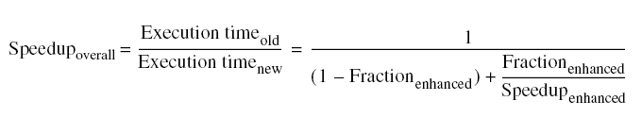
Amdahl’s Law
Improving an aspect of a computer and expecting a proportional improvement in overall performance

Slide 44
Example on Amdahl's Law
Suppose a program runs in 100 seconds on a computer, with multiply operation responsible for 80 seconds.
How much improvement in multiply performance to get the overall whole program 4 times faster?
Solution: suppose we improve multiplication by a factor s
25 sec (4 times faster) = 80 sec / s + 20 sec
s = 80 / (25 – 20) = 80 / 5 = 16
Improve the speed of multiplication by s = 16 times
How about making the program 5 times faster?
20 sec ( 5 times faster) = 80 sec / s + 20 sec
s = 80 / (20 – 20) = ∞ Impossible to make 5 times faster!

Slide 45
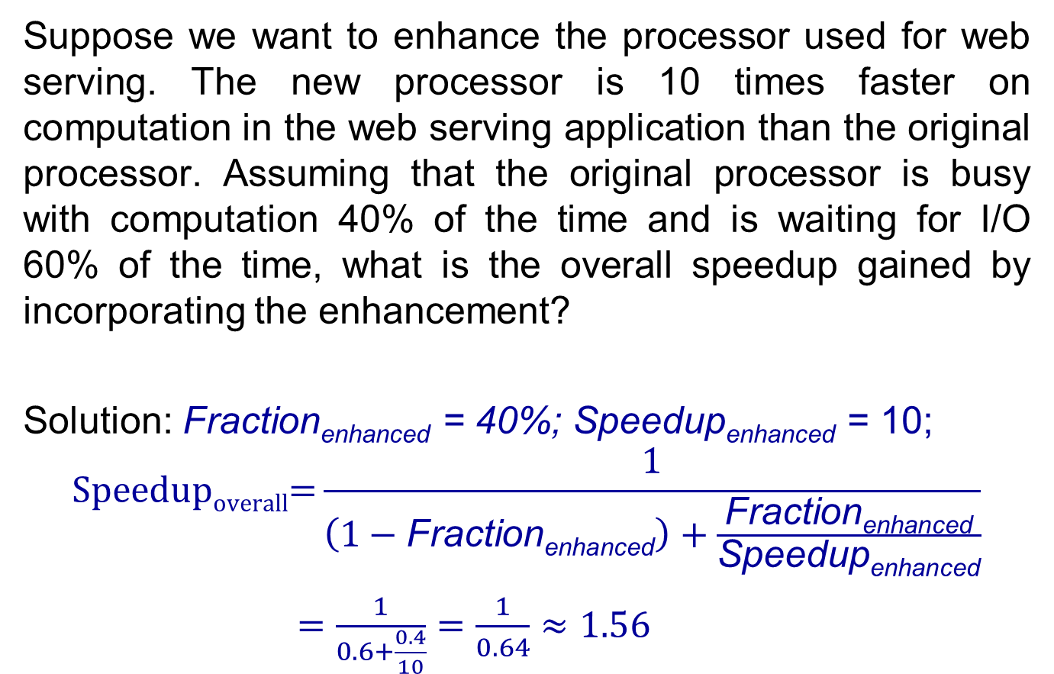
Examples on Amdahl's Law
Suppose we want to enhance the processor used for web serving. The new processor is 10 times faster on computation in the web serving application than the original processor. Assuming that the original processor is busy with computation 40% of the time and is waiting for I/O 60% of the time, what is the overall speedup gained by incorporating the enhancement?
Solution: Fraction_{enhanced} = 40%; Speedup_{enhanced} = 10;
$$\text{Speedup}\text{overall}\text{=}\frac{1}{\left(1−\text{Fraction}\text{enhanced}\right)+\frac{\text{Fraction}\text{enhanced}}{\text{Speedup}\text{enhanced}}}$$
$=\frac{1}{0.6+\frac{0.4}{10}}=\frac{1}{0.64}≈1.56$

Slide 46
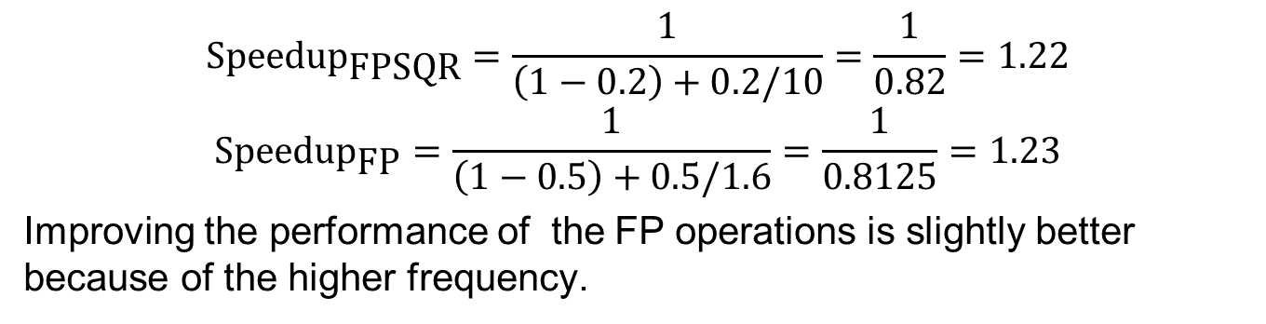
Exercise
A common transformation required in graphics processors is square root. Implementations of float-point (FP) square root vary significantly in performance, especially among processors designed for graphics.
Suppose FP instructions are responsible for 50% of the execution time for the application while square root (FPSQR) is responsible for 20% of the execution time of a critical graphics benchmark.
Proposal 1: enhance the FPSQR hardware and speedup this operation by a factor of 10.
Proposal 2: make all FP instructions in the graphics processor run faster by a factor of 1.6.
Compare these two proposals.
$${\text{Speedup}}_{\text{FP}\text{S}\text{QR}}=\frac{1}{\left(1−0.2\right)+0.2/10}=\frac{1}{0.82}=1.22$$
$${\text{Speedup}}_{\text{FP}}=\frac{1}{\left(1−0.5\right)+0.5/1.6}=\frac{1}{0.8125}=1.23$$
Improving the performance of the FP operations is slightly better because of the higher frequency.

Slide 47
Exercise 2
Suppose we have the following measurements:
Frequency of FP operations = 25%
Average CPI of FP operations = 4.0
Average CPI of other instructions = 1.33
Frequency of FPSQR = 2%
CPI of FPSQR = 20
Proposal 1: decrease the CPI of FPSQR to 2
Proposal 2: decrease the average CPI of all FP operations to 2.5.
Compare these two design alternatives using the processor performance equation.

Slide 48
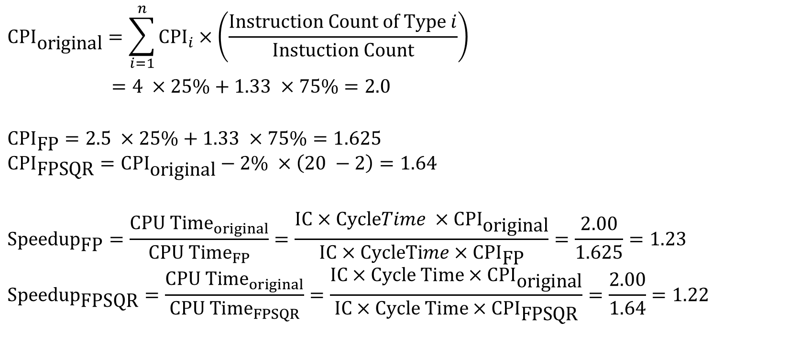

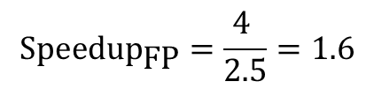
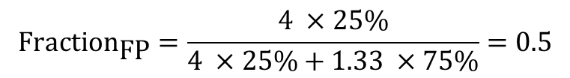
Solution to Exercise 2
$${\text{CPI}}_{\text{original}}=\sum_{i=1}^{n}{{CPI}_{i}}×\left(\frac{Instruction Count of Type i}{Instuction Count}\right)$$
$=4 ×25\%+1.33 ×75\%=2.0$
$${\text{CPI}}_{\text{FP}}=2.5 ×25\%+1.33 ×75\%=1.625$$
$${\text{CPI}}_{\text{FP}\text{SQR}}={\text{CPI}}_{\text{original}}−2\% ×\left(20 −2\right)=1.64$$
$${\text{Speedup}}_{\text{FP}}=\frac{{CPU Time}_{original}}{{CPU Time}_{FP}}=\frac{IC×CycleTime ×{\text{CPI}}_{\text{original}}}{IC×CycleTime×{\text{CPI}}_{\text{FP}}}=\frac{2.00}{1.625}=1.23$$
$${\text{Speedup}}_{\text{FP}\text{SQR}}=\frac{{CPU Time}_{original}}{{CPU Time}_{FPSQR}}=\frac{IC×Cycle Time×{\text{CPI}}_{\text{original}}}{IC×Cycle Time×{\text{CPI}}_{\text{FP}\text{SQR}}}=\frac{2.00}{1.64}=1.22$$
$${\text{Fraction}}_{\text{FP}}=\frac{4 ×25\%}{4 ×25\%+1.33 ×75\%}=0.5$$
$${\text{Speedup}}_{\text{FP}}=\frac{4 }{2.5}=1.6$$
$${\text{Speedup}}_{\text{FP}}=\frac{1}{\left(1−0.5\right)+0.5/1.6}=\frac{1}{0.8125}=1.23$$

